Slide 1

Design and proof-of-concept of the Integration of an Electric Scooter with a Wheelchair: from the Mechanical Design to the Firmware Upgrade
Intro Idea Project Protocol Firmware Conclusions
Luca Tomei, 1759275
Advisor: Dr. Andrea Vitaletti
October 20, 2021
Master of Science in Engineering in Computer Science
M.Sc. Engineering in Computer Science
Notes:
Good morning everyone, I'm Luca Tomei and I am going to show the presentation of my thesis work whose title is "Design and proof-of-concept of the Integration of an Electric Scooter with a Wheelchair: from the Mechanical Design to the Firmware Upgrade".

Slide 2
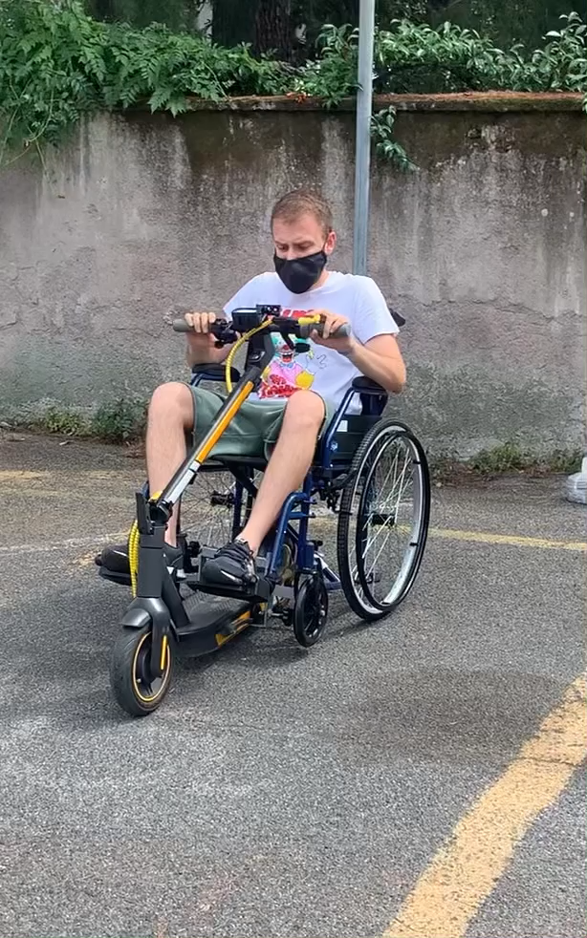
Intro Idea Project Protocol Firmware Conclusions
Thesis Focus E-Scooter Problems
Thesis Focus
IDEA:
Use the same tool for both able-bodied and disabled people in the same family.
Realization of a working and economical prototype without the modification of the Wheelchair and Electric Scooter.
Main Contribution:
Firmware Reverse Engineering.
Custom Firmware Injection.
Realization and creation of metal support to couple Electric Scooter to the Wheelchair.
Real-Life Experimental Results.
M.Sc. Engineering in Computer Science
Notes:
The aim of the project is to extend the use of an electric scooter to people with disabilities so that the same family can share the same means of motion. It was decided to not make any changes to neither the wheelchair nor the electric scooter, making as easy as possible for the two parts to be coupled and used together. But we have found two main problems: First. we must allow the electric scooter to start from a standstill and Second. we need to create the coupling of the two components.
Since the firmware of an electric scooter is owned by the manufacturer and is not available, it was decided to reverse engineer it by monitoring the packets exchanged between the smartphone and the vehicle.
As will be shown, this leads to a serious security problem in this IT product and after extracting and modifying the encrypted firmware, we made a steel bracket that allows attachment to a wheelchair. Finally, road tests were carried out to analyse the behavior of this software modification in order to make improvements and obtain data that would make driving safe without causing damage to people, battery or other components.

Slide 3
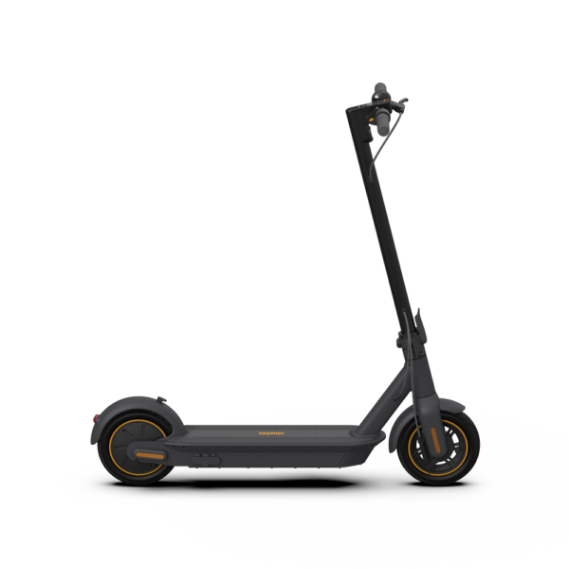
Intro Idea Project Protocol Firmware Conclusions
Thesis Focus E-Scooter Problems
Electric Scooter - Disability Problem
Only able-bodied people
No standing start
Poor modularity
M.Sc. Engineering in Computer Science
Notes:
The popularity of electric scooters has increased in recent years.
However, the structure of such a vehicle imposes several constraints that apparently cannot be overcome by disabled people: for example, they can only be ridden by who can stand up and there is no possibility to start from a standstill as a small push with the feet is required to start the ride. Finally, electric scooters have little modularity, that is they are difficult to adapt to various uses.

Slide 4
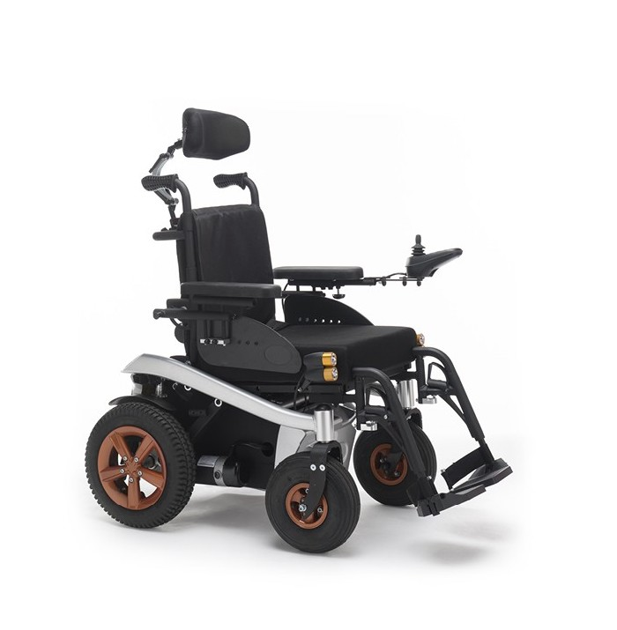
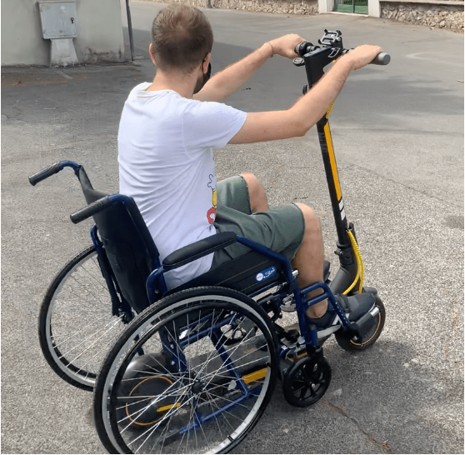


Intro Idea Project Protocol Firmware Conclusions
Solutions - Price Comparison
2555€
500€
M.Sc. Engineering in Computer Science
Notes:
To overcome this problem, this project provides a different use of the wheelchair and electric scooter and, as is shown in this slide by a price comparison, it is possible to add traction to a normal wheelchair at a lower cost than a motorised one.

Slide 5
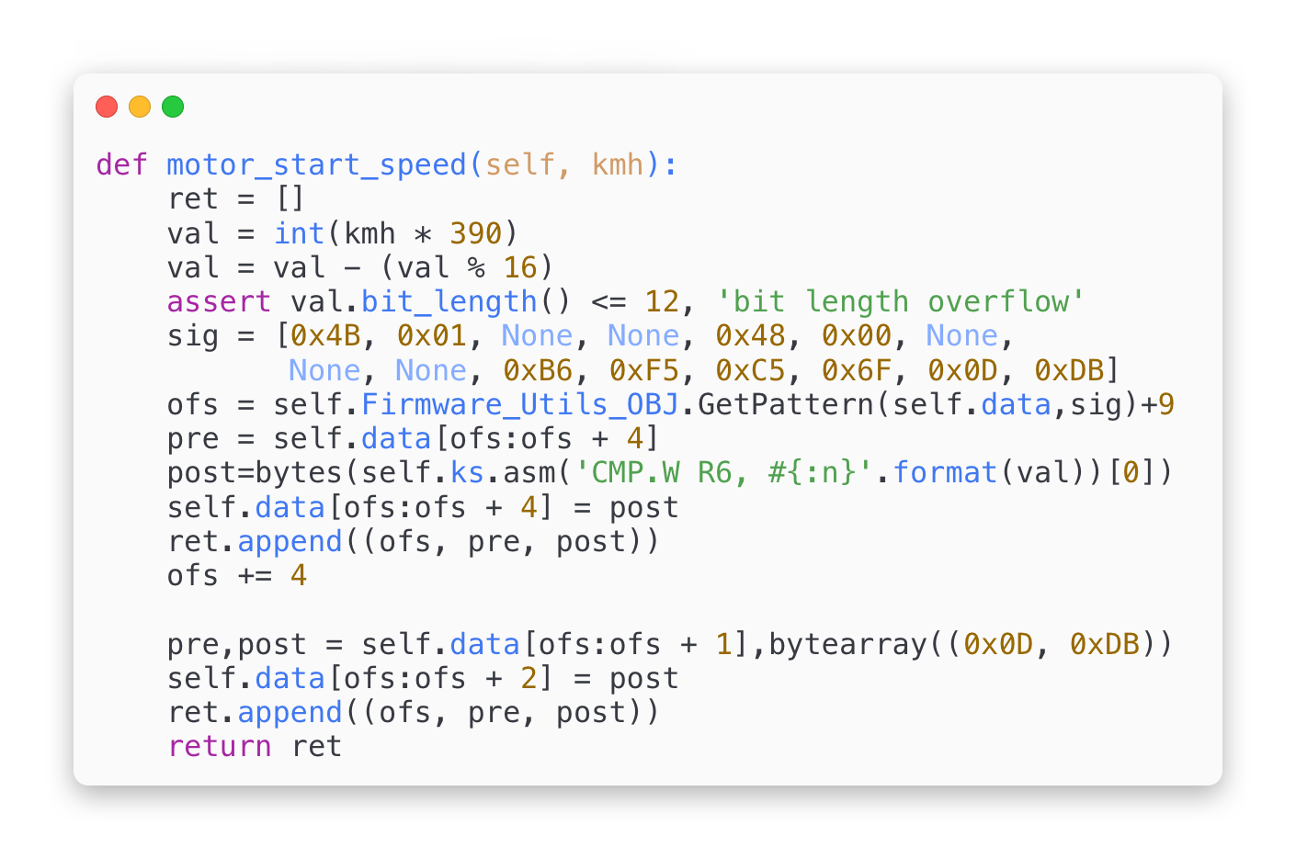

Intro Idea Project Protocol Firmware Conclusions
Background Realization
Idea Development - Background
Wheelchair Bracket
Project Code
M.Sc. Engineering in Computer Science
Notes:
Very quickly I want to show a representative scheme that summarises the idea of my thesis project, which consists of the design and implementation of a metal support and the development of a custom firmware that allows the driveability of the electric scooter coupled to the wheelchair.

Slide 6
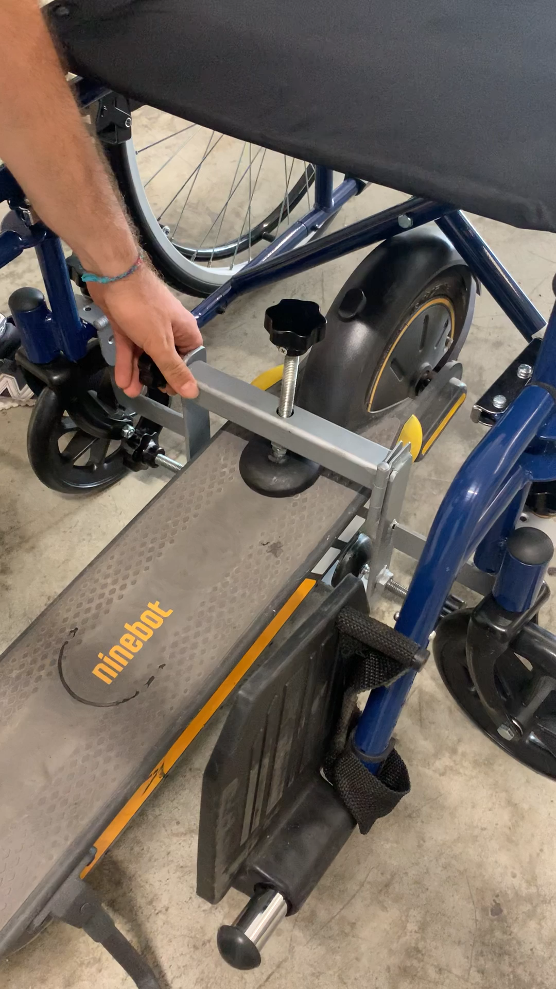
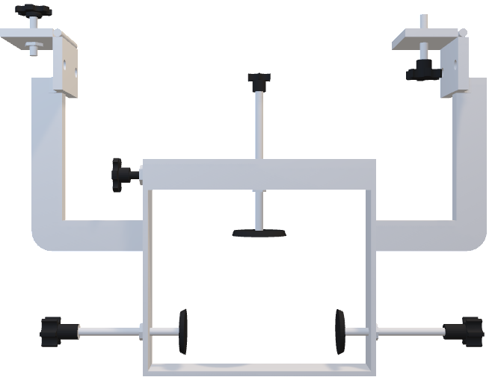
Intro Idea Project Protocol Firmware Conclusions
Background Realization
Idea Development – Realization
M.Sc. Engineering in Computer Science
Notes:
Here we can see how from the Autocad project we go to the concrete realisation of the bracket, which in the figure on the right is hooked to the wheelchair and installed near the rear wheels. This support, consisting of 3 knobs and 3 vibration dampers, allows the front wheels of the wheelchair to be raised and prevents longitudinal and transversal movements resulting from towing.

Slide 7
Intro Idea Project Protocol Firmware Conclusions
E-scooter – Firmware Modification
IMPLEMENTATION
M.Sc. Engineering in Computer Science
Notes:
Now let's talk about the steps that made it possible to communicate with the vehicle and modify its parameters.

Slide 8
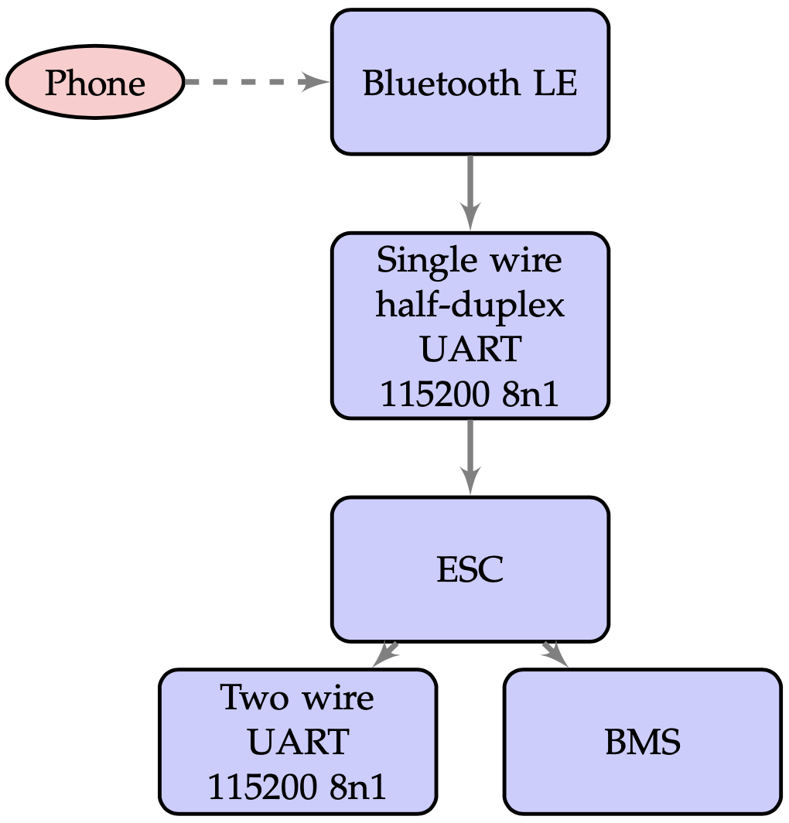
E-scooter - Communication Protocol
Intro Idea Project Protocol Firmware Conclusions
Bluetooth communication between the scooter and the smartphone was used as a means to obtain information about the scooter's firmware, parameters and configuration settings.
M.Sc. Engineering in Computer Science
Notes:
The process of interaction between the electric scooter and the smartphone takes place through Bluetooth connection as shown in the figure. This protocol defines the general format by which the Ninebot and Xiaomi electronic control system achieves multi-node communication via physical and Bluetooth serial ports. To use serial port communication must be used a baud rate of 1 hundred and 15 thousand 2 hundred, 8-byte word without verification and 1 stop bit. Information retrieval, control and parameter modification can be achieved through a read-write operation to the "memory control table" which is stored in the controller.

Slide 9
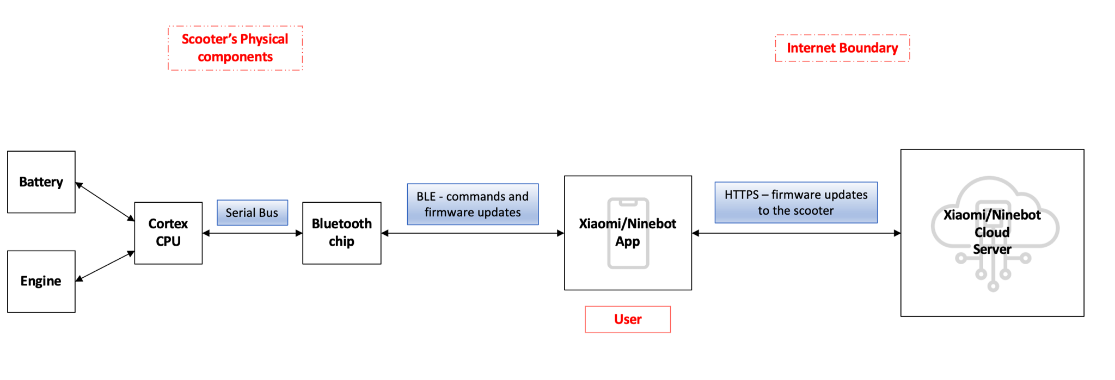
E-Scooter - App Communication Diagram
Intro Idea Project Protocol Firmware Conclusions
Block diagram of the communication between the processor of the scooter and its official application.
Bluetooth Low Energy as a channel for communicating commands, firmware updates and changes in settings.
M.Sc. Engineering in Computer Science
Notes:
Extrapolating data from the GET/POST requests made by the application of the electric scooter connected to the phone, we realise that this technology is used as a means of transmitting various types of updates. Knowing how the two entities communicate is essential to proceed to modify the firmware parameters.
In fact, the figure below describes the various connection phases that the electric scooter performs while communicating with the parent cloud server. The user's application sends requests to the server, which immediately responds with updates for the vehicle. All this takes place under a Bluetooth connection between the smartphone and the chip in the electric scooter in order to issue commands to the control unit and the engine.

Slide 10
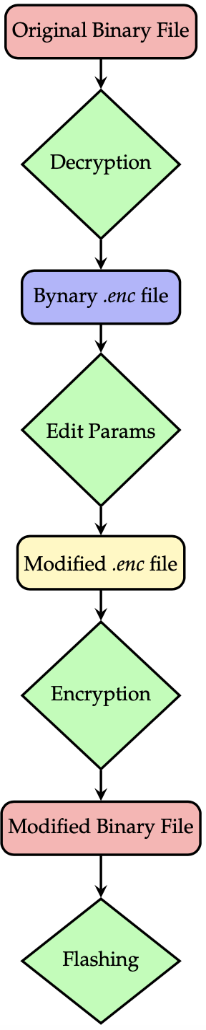
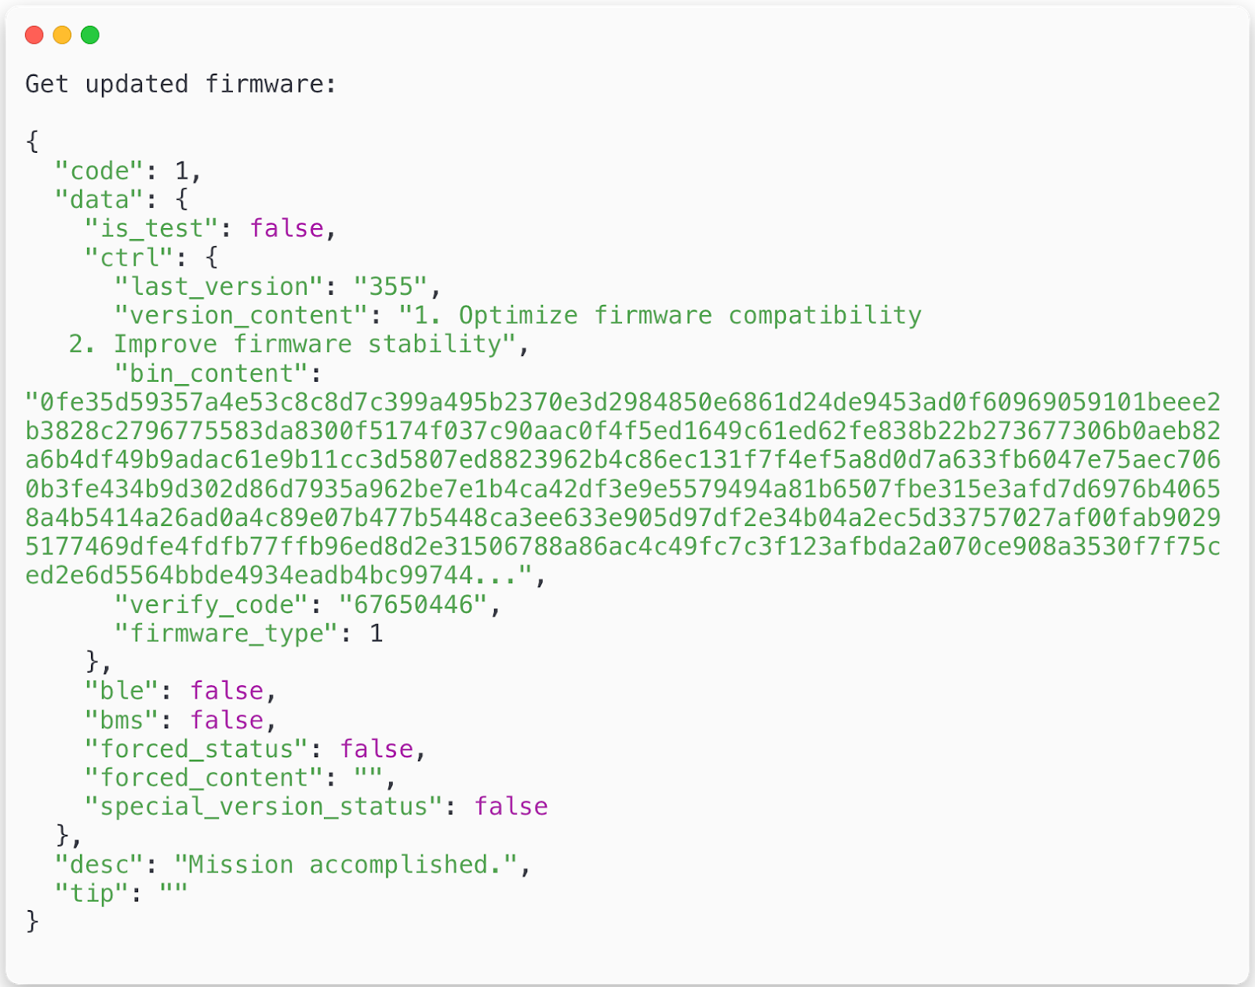
E-scooter - Firmware Sniffing
Intro Idea Project Protocol Firmware Conclusions
Checking the scooter firmware via communication with the smartphone application allows you to obtain the binary file of the electric scooter firmware in clear text.
M.Sc. Engineering in Computer Science
Notes:
The original firmware cannot handle towing a wheelchair due to various limitations imposed by the manufacturer. For example, it is necessary to provide a standing start, increased acceleration, and limit speed in order to be used by people with disabilities.
Here you can see the block diagram that has been followed to perform a firmware modification. In particular, after obtaining the original firmware from the analysis of HTTPS packets exchanged with the smartphone, it is necessary to decrypt the binary file then proceed to change the parameters of interest. Finally, we need to encrypt the binary firmware and flash it on the memory of the electric scooter.

Slide 11
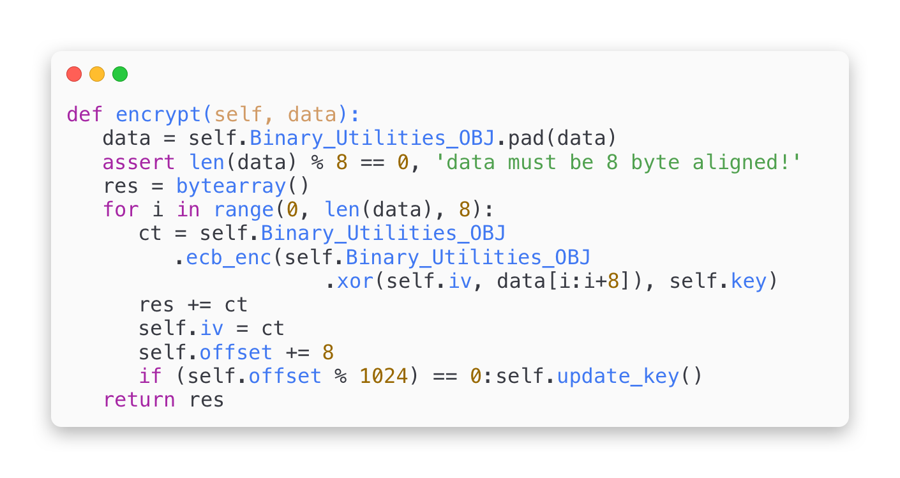
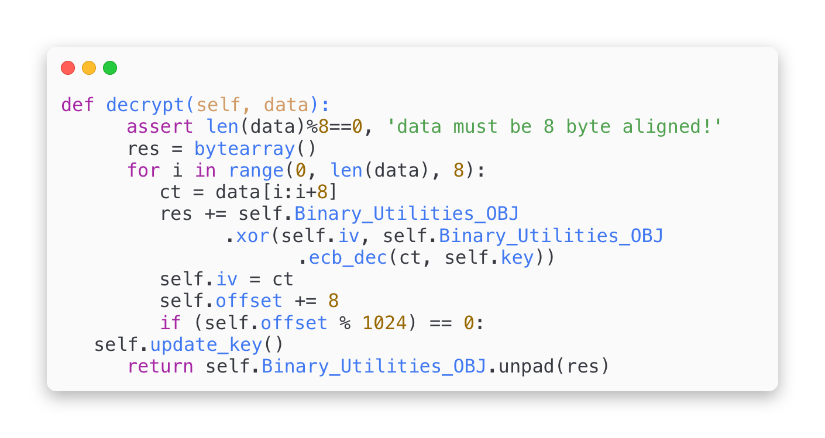
E-scooter - Firmware Encryption/Decryption
Intro Idea Project Protocol Firmware Conclusions
Encryption/Decryption CFW FW Generator
The firmware obtained from the packet analysis must be decrypted to allow the modification of its parameters.
Once the parameters of the custom firmware have been modified, it must be encrypted and then flashed on the electric scooter.
M.Sc. Engineering in Computer Science
Notes:
A first careful analysis of the binary file obtained from packet sniffing was performed with a decompiler that makes readable the values present in that data structure. Subsequently, various functions were implemented to encode and decode firmware of Xiaomi and Ninebot electric scooters. The first python function shown in this slide takes as input the "sniffed" file and returns as output a decrypted one that will be used to modify the parameters. The second function will be used last to make compatible the modified file with the original one, before flashing on the electric scooter.

Slide 12
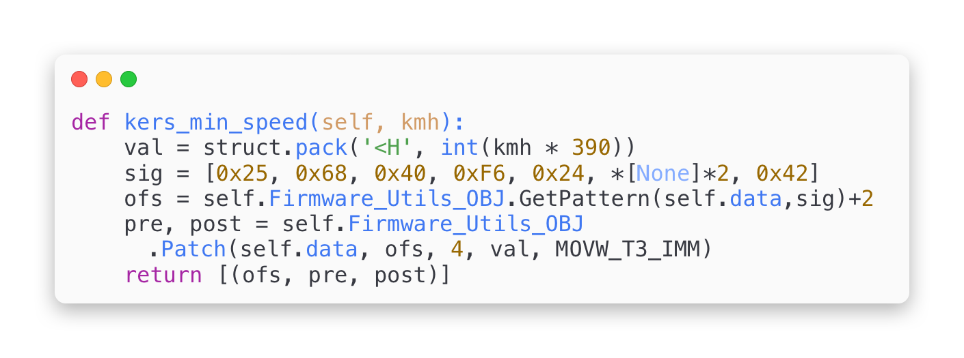
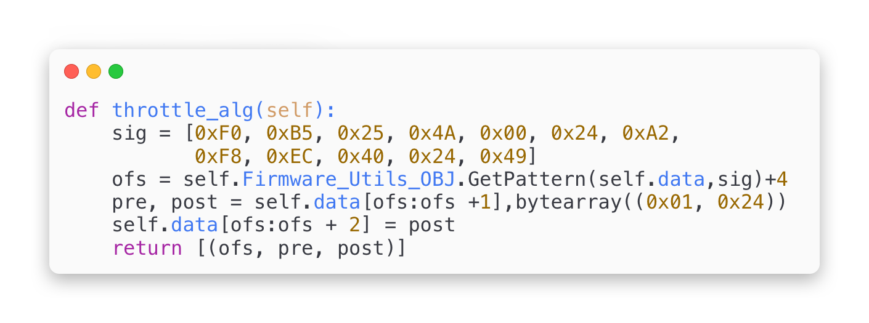
E-scooter - Modify Firmware Parameters
Intro Idea Project Protocol Firmware Conclusions
Encryption/Decryption CFW FW Generator
Set KERS Minimum Speed
Starting From Standstill
Edit Accelerator Curve
12 / 20
M.Sc. Engineering in Computer Science
Notes:
After decoding the binary file, we can proceed with modifying the parameters of interest like acceleration, KERS, starting speed, cruise control, motor power constant and top speed.
As you can see from the pieces of code shown, Python functions take various arguments as input, allowing you to modify those parameters according to your inclinations and needs.
Each function uses the auxiliary method "GetPattern" which is used to obtain the pattern in the binary structure of the data to be modified.
It takes the bitearray data structure as input and searches through it, returning the index to be used to modify the desired value.

Slide 13
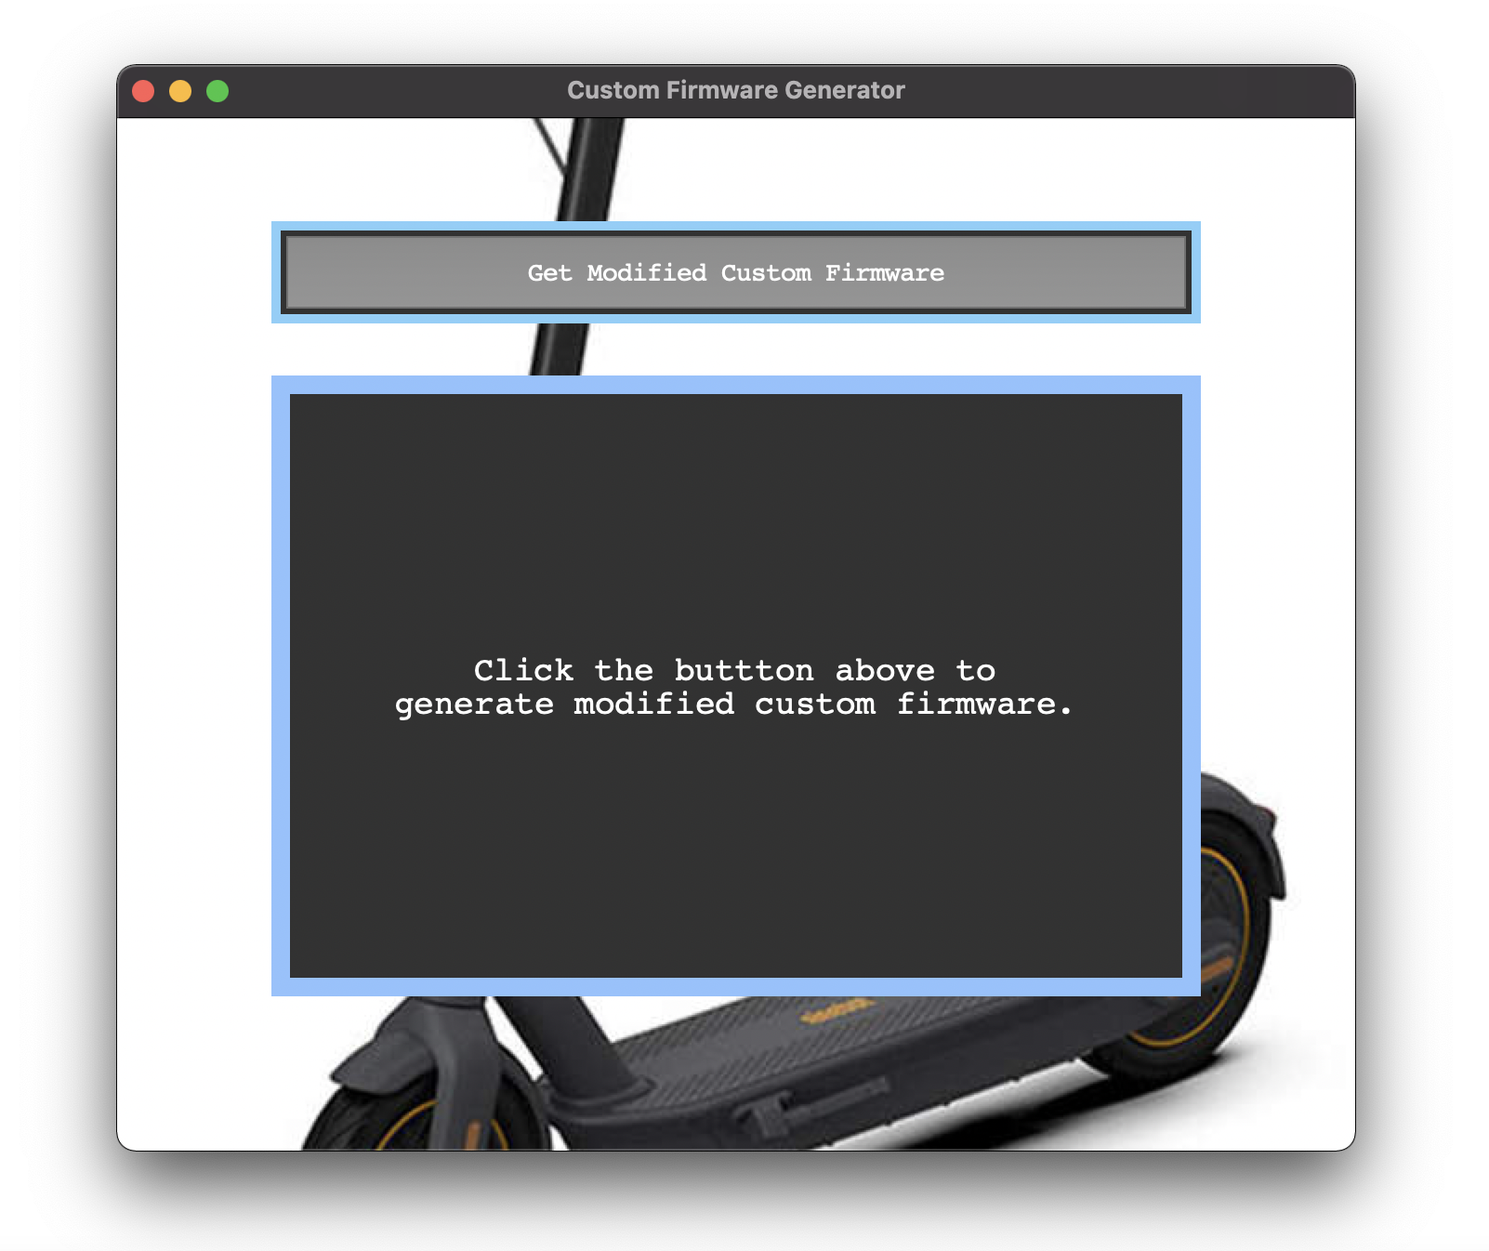
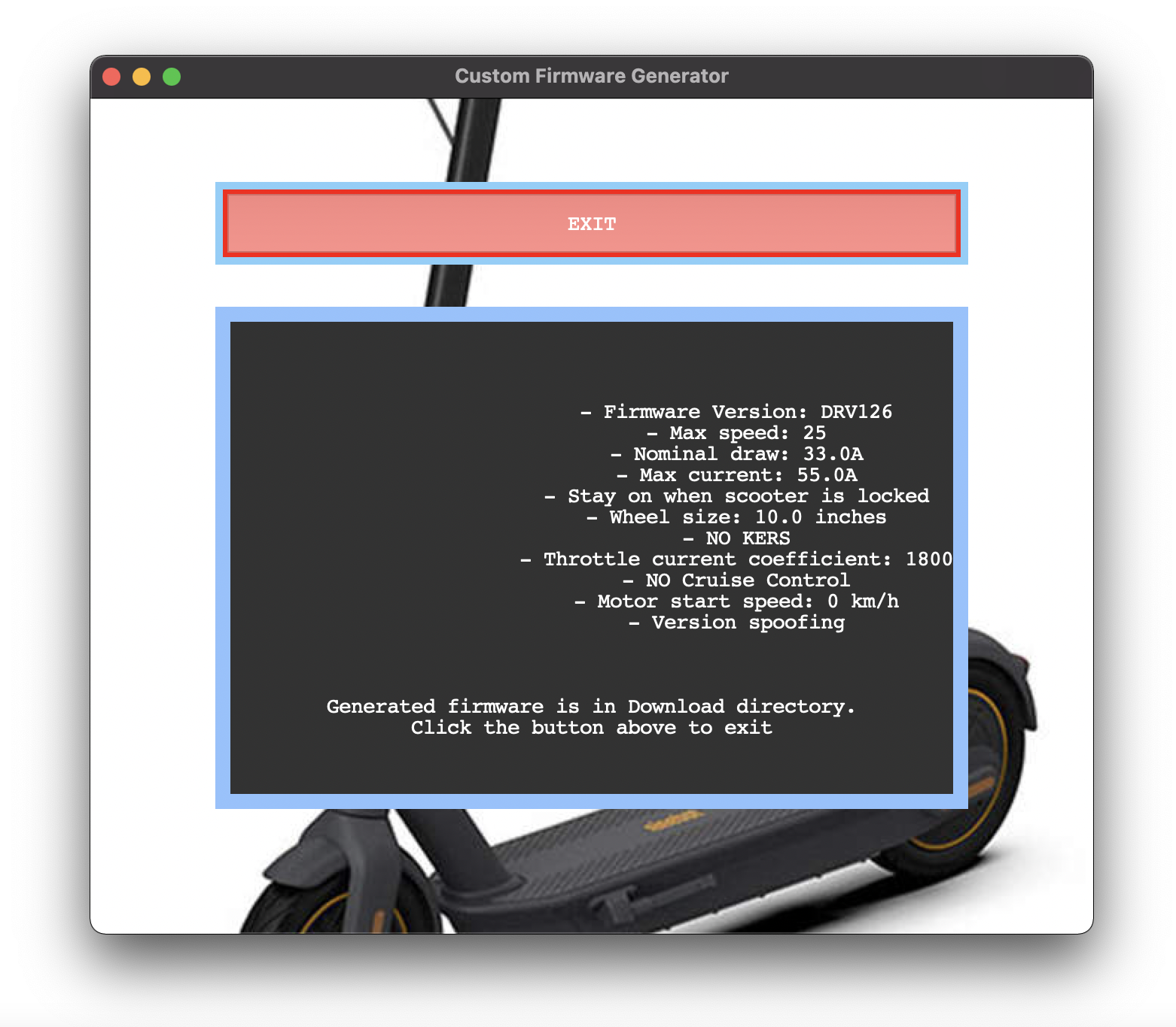
E-scooter - GUI for automatic firmware generation
Intro Idea Project Protocol Firmware Conclusions
Encryption/Decryption CFW FW Generator
Automated custom firmware generator
13 / 20
M.Sc. Engineering in Computer Science
Notes:
In order to facilitate and automate the creation of the custom firmware, a software with graphical interface has been created that, integrating the functions described above, generates a binary file ready for flashing on the electric scooter.
At the end of the wizard, by clicking the "EXIT" button the firmware will be saved in the download folder in ZIP format. At this point it will be sufficient to use one of the third part software available on AppStore or PlayStore to flash it on the vehicle and start the road test.

Slide 14
E-scooter + Wheelchair – Experimental Results
Intro Idea Project Protocol Firmware Conclusions
PERFORMANCE
EVALUATION
14 / 20
M.Sc. Engineering in Computer Science
Notes:
Now, we will illustrate several graphs aimed at showing the performance of the electric scooter both with the standard firmware, driven without the wheelchair, and with the customised firmware driven together with the wheelchair.

Slide 15
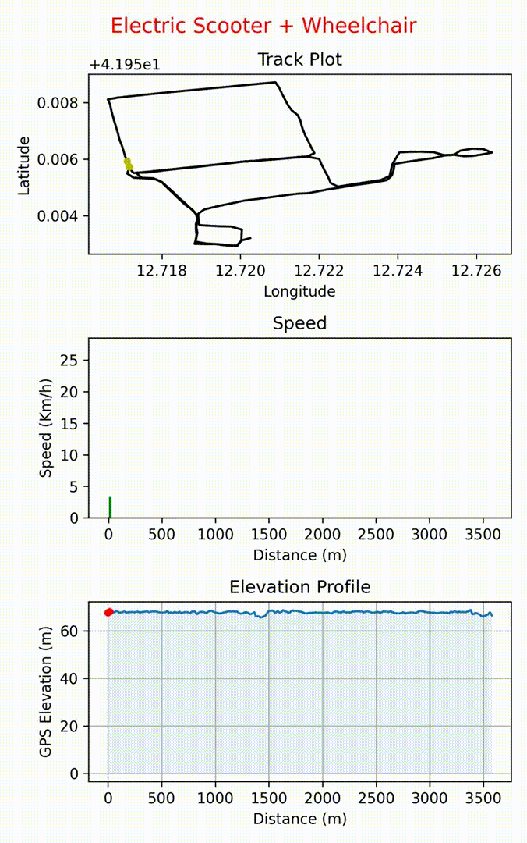
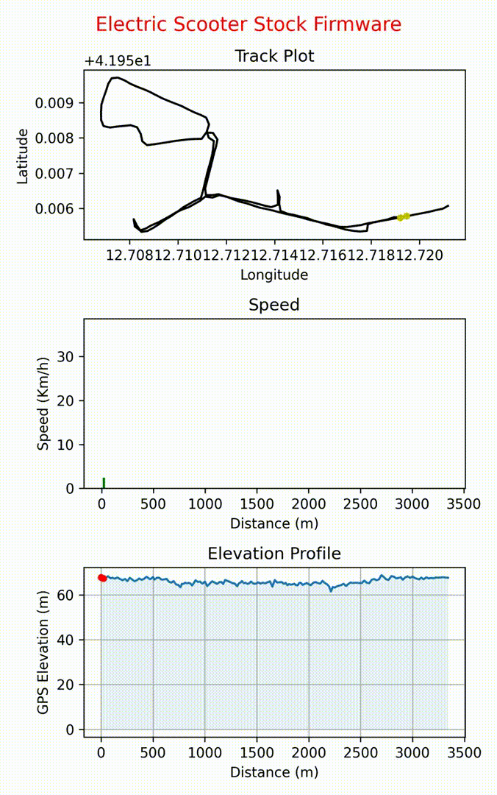
Intro Idea Project Protocol Firmware Conclusions
Experimental Results
Distance Traveled during Road Test
15 / 20
M.Sc. Engineering in Computer Science
Notes:
During the various road tests, we have collected data and then analysed and transformed using the Python matplotlib library to generate static and dynamic graphs regarding distance travelled, speed and slope of the ground. In order to analyse the differences in behaviour between the two firmwares, we tried to follow the same route for both test drives, which were carried out on a mostly flat road at a speed as constant as possible.

Slide 16
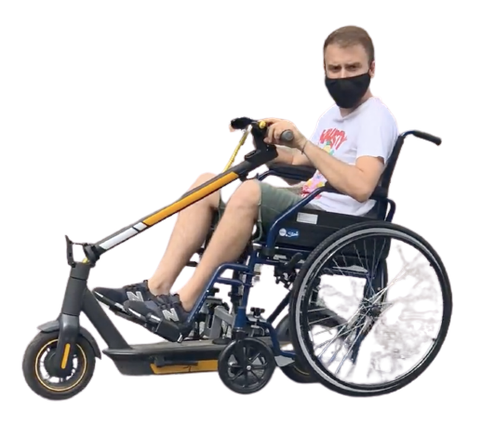
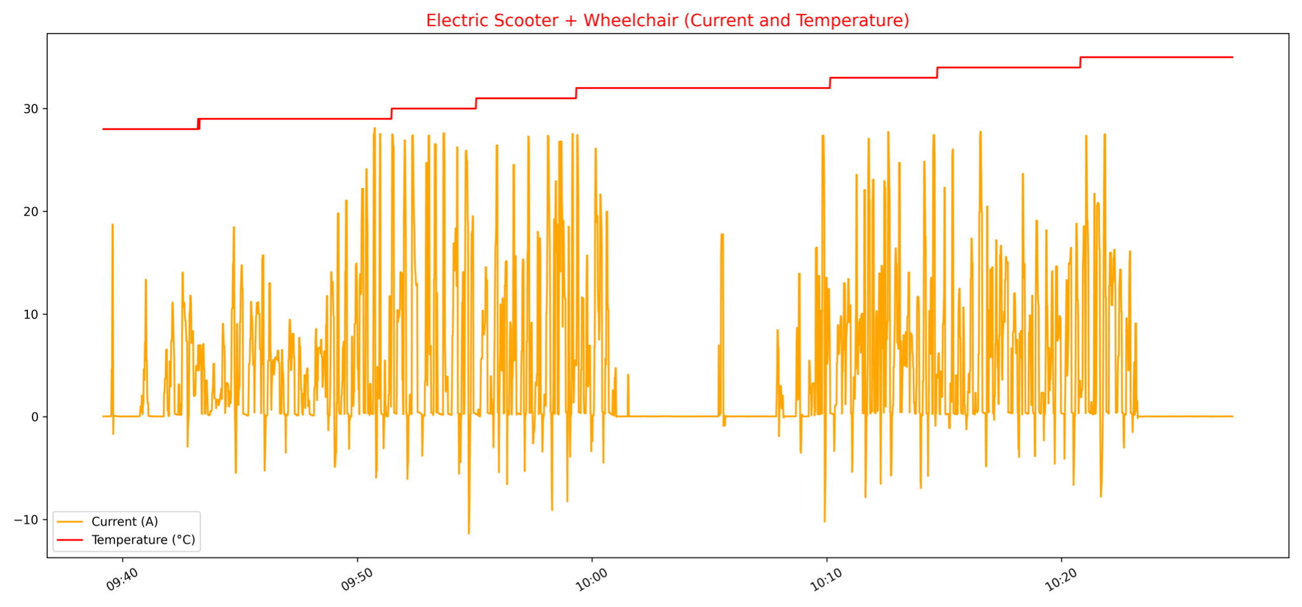
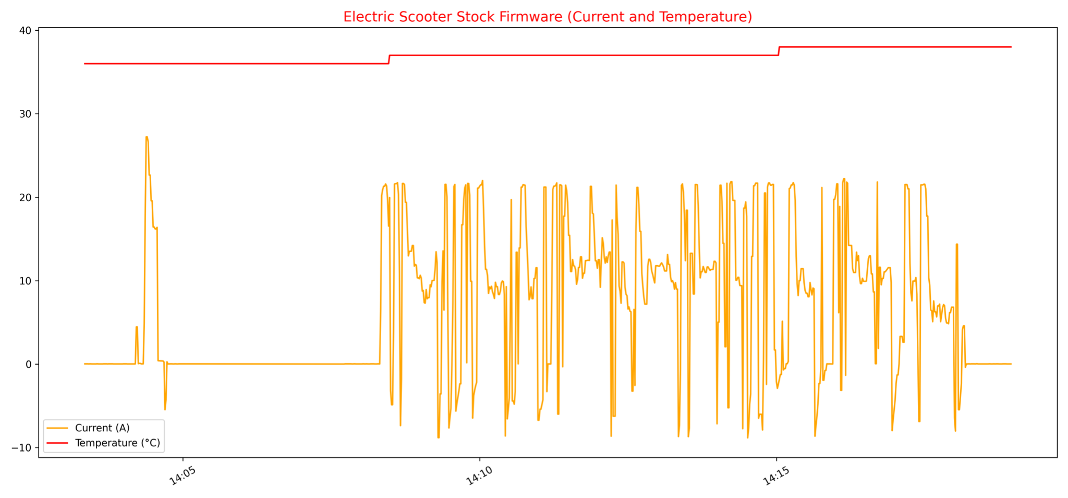
Intro Idea Project Protocol Firmware Conclusions
Experimental Results
Current and Temperature Over Time
16 / 20
M.Sc. Engineering in Computer Science
Notes:
These figures show the trend in time of current and temperature. The current reaches positive peaks during acceleration and negative peaks during braking when the kinetic energy recovery system takes over. When the electric scooter is used with a wheelchair, the amplitude of these peaks is greater, so more energy will be recovered during braking.
It can be seen that the temperature is in the range of 28 to 34 Celsius degrees, which is a lower range than when used without a wheelchair. Operating at a lower temperature will extend the battery life and the kilometres travelled.
In the second figure we can see that the negative peaks are smaller in amplitude due to the reduced mass.
For the temperature we can observe that, as time passes, it is close to 40 degrees centigrade. This significant difference is due to the different law that regulates acceleration, a linear law that provides higher and more extended current levels in time.

Slide 17
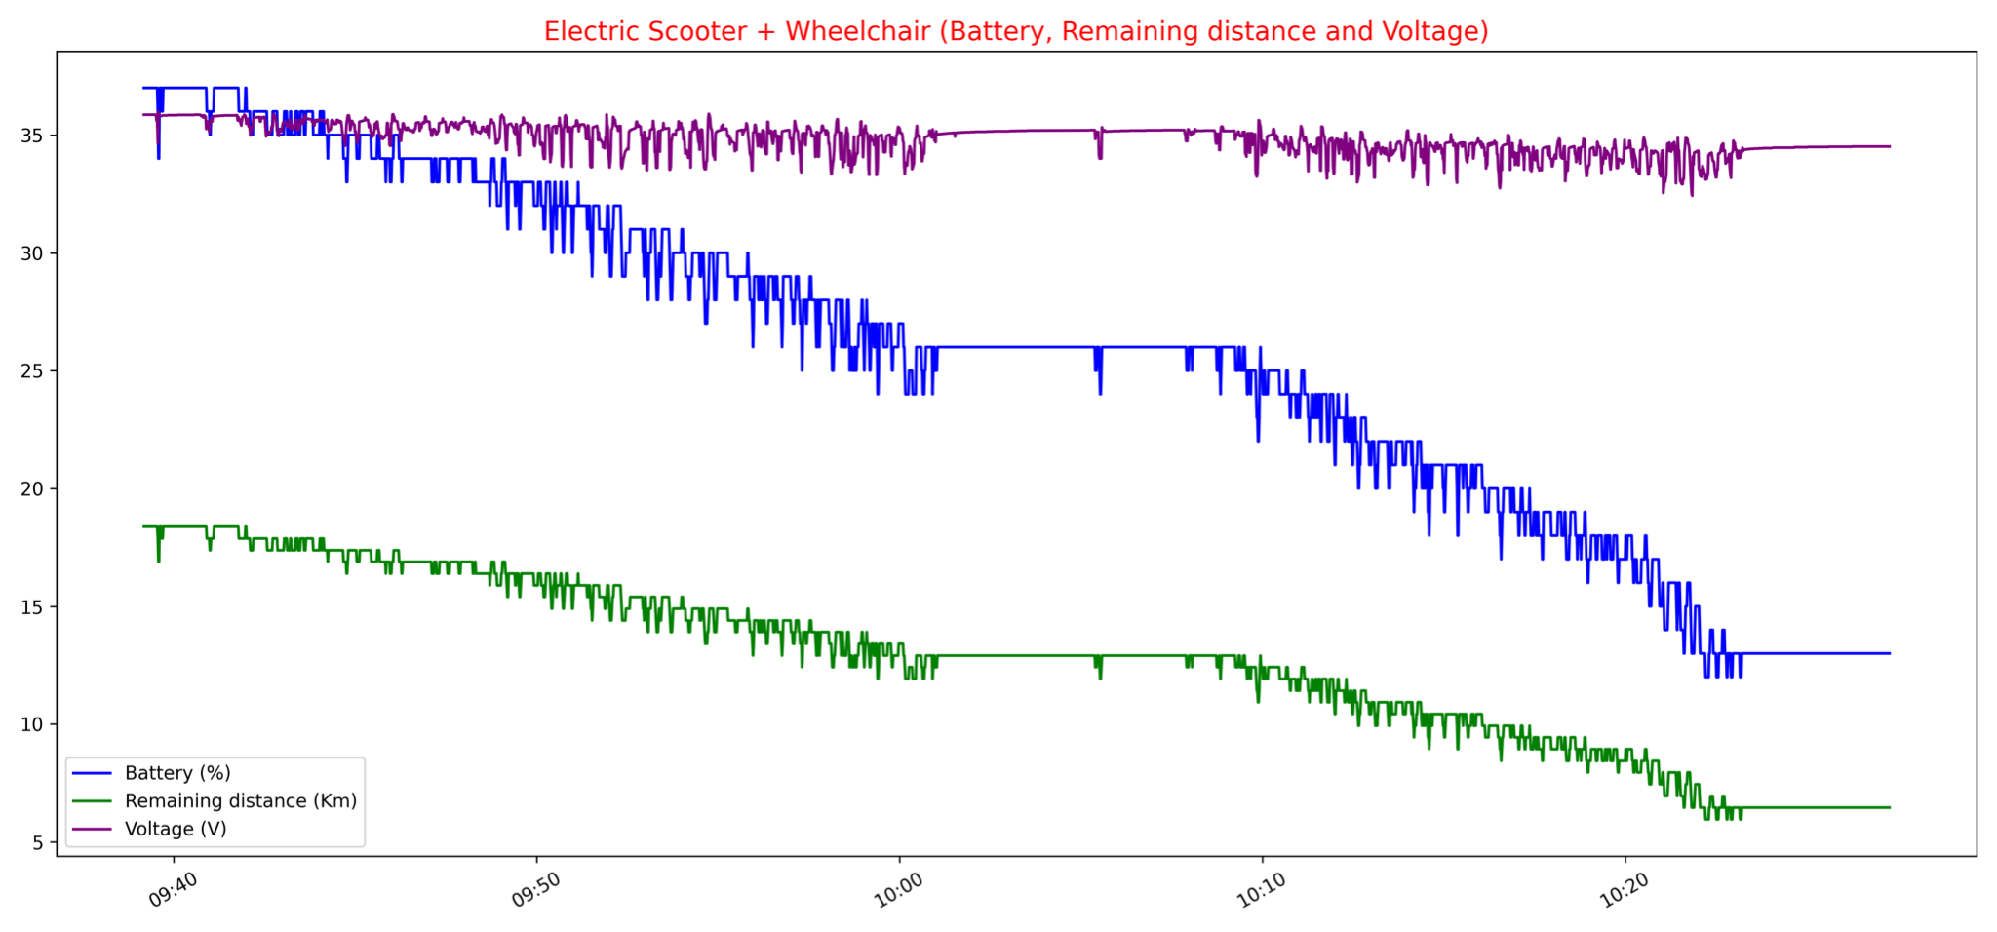
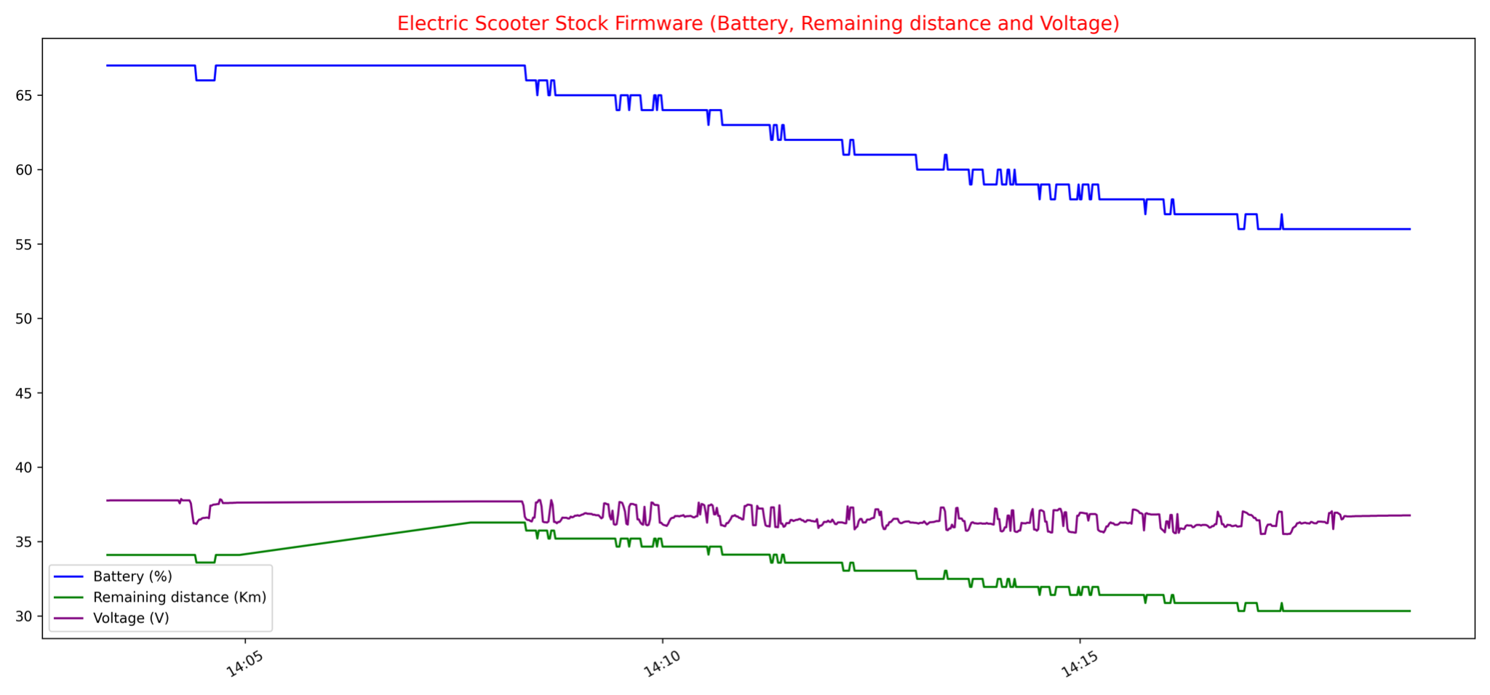
Intro Idea Project Protocol Firmware Conclusions
Experimental Results
Battery, Remaining Distance and Voltage Over Time
17 / 20
M.Sc. Engineering in Computer Science
Notes:
The following graphs show the trend of battery discharge, remaining distance and available voltage over time.
Obviously these three parameters depend directly on the weight of towed mass, in fact in the first case the discharge of the battery has a much steeper trend, the energy demand is very high but is compensated by the recovery system.
Instead in the second case we notice that the standard firmware guarantees a more contained use of the available energy and the energy recovery peaks are lower in amplitude and frequency.

Slide 18
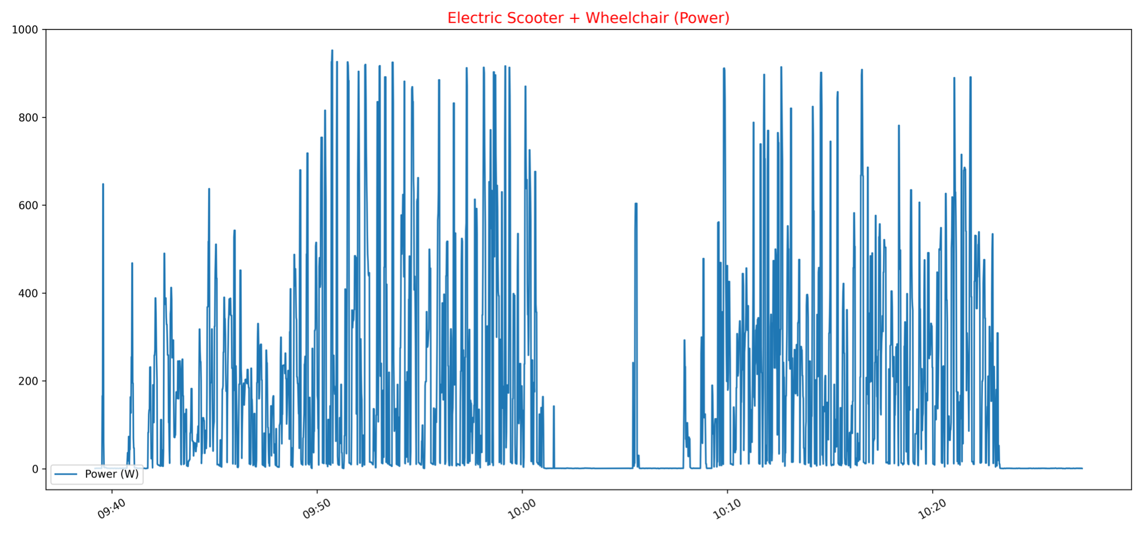
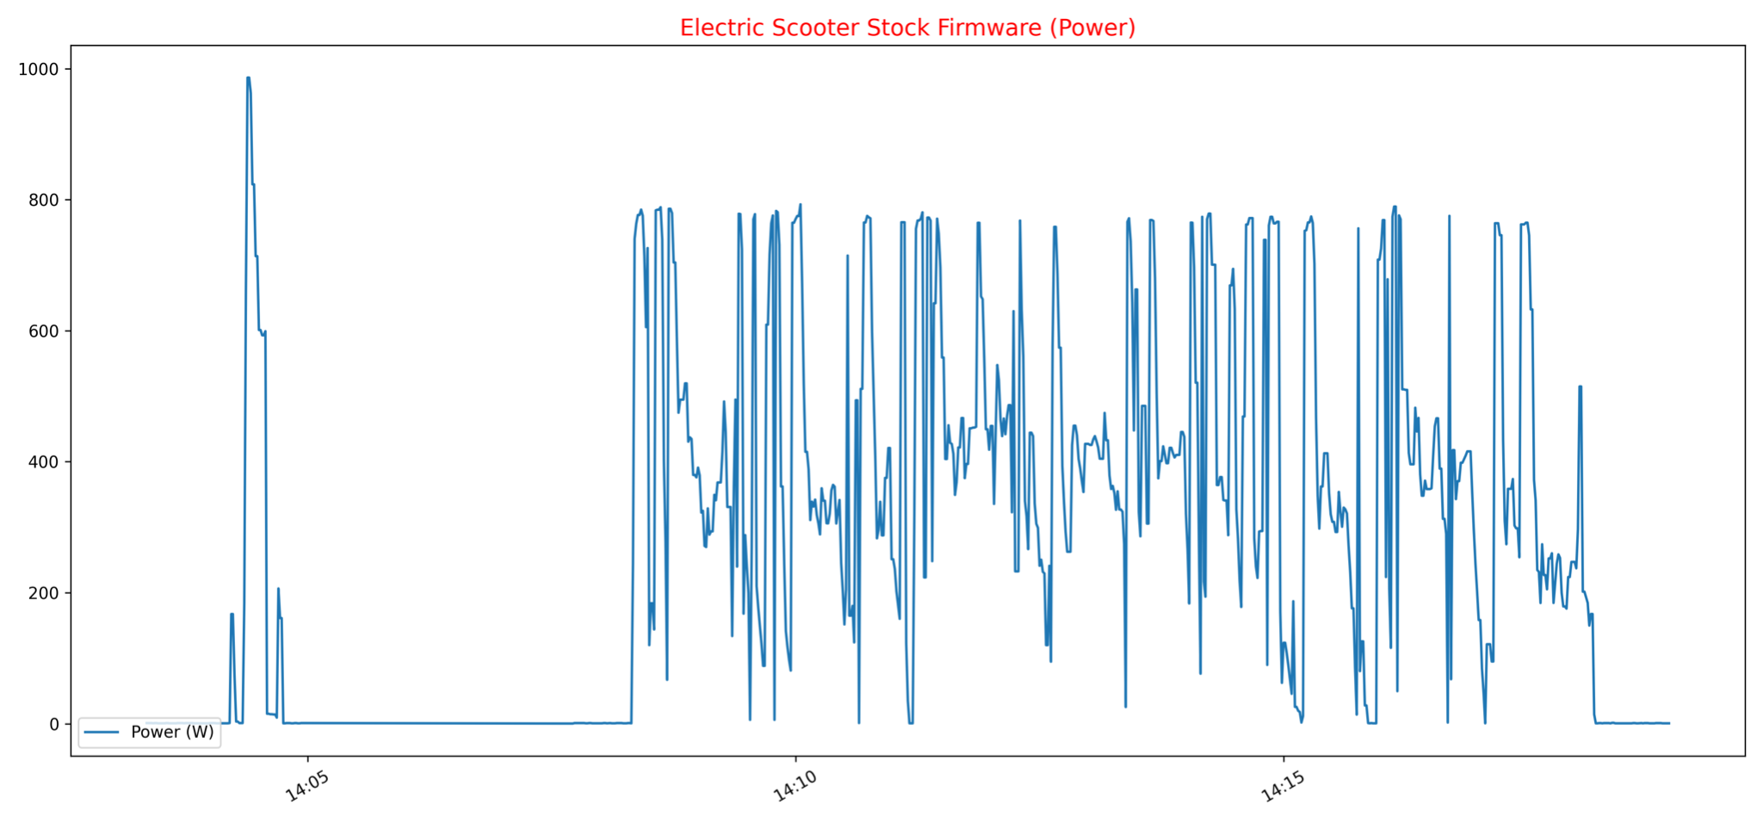
Intro Idea Project Protocol Firmware Conclusions
Experimental Results
Power Over Time
18 / 20
M.Sc. Engineering in Computer Science
Notes:
Regarding the power delivered by the engine, to ensure greater acceleration and starting from a standstill, the custom firmware generates peaks that are much higher than in the case of the stock one, who reaches the average power level of 780 watts compared to the 980 watts obtained when towing the wheelchair.
These values are related only to one of the three driving modes of the electric scooter, the sport mode, since during the customization of the firmware it was decided to leave the other two modalities unchanged to ensure a longer battery life.

Slide 19
Conclusions - Summary
Intro Idea Project Protocol Firmware Conclusions
Thesis Focus:
Modify the stock firmware of the electric scooter in order to make it usable as a traction and movement tool for disabled people.
Contributions:
Analysis and modification of the firmware of an electric scooter
Implementation of software that automates the process of generating custom firmware
Realization of metal support to ensure mechanical coupling between electric scooter and wheelchair
Experimental results that show the feasibility of the project
19 / 20
M.Sc. Engineering in Computer Science
Notes:
The main objective of this thesis was to demonstrate and realise the feasibility of having an economic solution that allow the use of the same means of motion by both able-bodied people and people with disabilities. Moreover, this result has been achieved without modifying in any way the structure of the electric scooter and the wheelchair. In fact, to allow the drivability of the electric scooter in this new field of use, it is only necessary the modification of the software and the realisation of the mechanical coupling between the two parts.

Slide 20




Thesis, slides, code and videos are all available at:
Intro Idea Project Protocol Firmware Conclusions
Thank you!
Luca Tomei
tomei.1759275@studenti.uniroma1.it
20 / 20
M.Sc. Engineering in Computer Science
Notes:
Thank you for your attention.
Librerie enc/dec = struct → Interpret bytes as packed binary data in little-endian ordered unsigned long value,
Keystone → Keystone compile in this case arch arm assembly instruction to thumb (thumbs are set of 16 bit instructions)
Librerie GUI: tkinter, PIL
Librerie grafici: matplotlib.pyplot, matplotlib.animation
Future Works:
obtaining a finer tuning of the firmware parameters and thus more effective and comfortable for driving by people with disabilities
video cameras could be integrated into the electric scooter and then used to be able to have a representation of the outside world and based on this ensure greater safety
it might be possible to extend this product to sharing companies so that electric scooters can be rented out to a wide audience of people with mobility problems, thus enabling the rental of scooters by these people.

